Slide 1

Making PgWeb Rock Solid
Using the Testing Harness to ensure the quality of pgweb
Akshat Jaimini - PGConfEU 2023, Prague

Slide 2
About Me!
I am Akshat Jaimini.
Undergraduate Engineering Student at Thapar University, India.
Joined the PostgreSQL community in 2023
I Love Opensource!
PS: I am also a MetalHead ;)
Notes:
Akshat Jaimini, an undergraduate engineering student from India. I joined the PostgreSQL community this year only and I also love to hack on random codebases and make music.

Slide 3

About the project & GSoC
Google Summer (of Code) program
PostgreSQL has been a part of GSoC since 2006
Proposed back in 2021, finally picked up pace in 2023!
Simple to use CI testing framework for pgweb
Notes:
So first of all let’s discuss what happenWe wanted to develop a simple to use testing framework that easily integrates with a CI environment

Slide 4
Today’s Presentation
What…
Why…
Is pgweb?
Do we need to
test pgweb?
How...
Where…
Does the harness work?
Do we plan to be in the future?
Notes:
We’ll see what pgweb is. Just a brief overview for everyone. After that we’ll look at why do we even need to test a website. Then we’ll understand how the harness works and discuss some future plans.

Slide 5
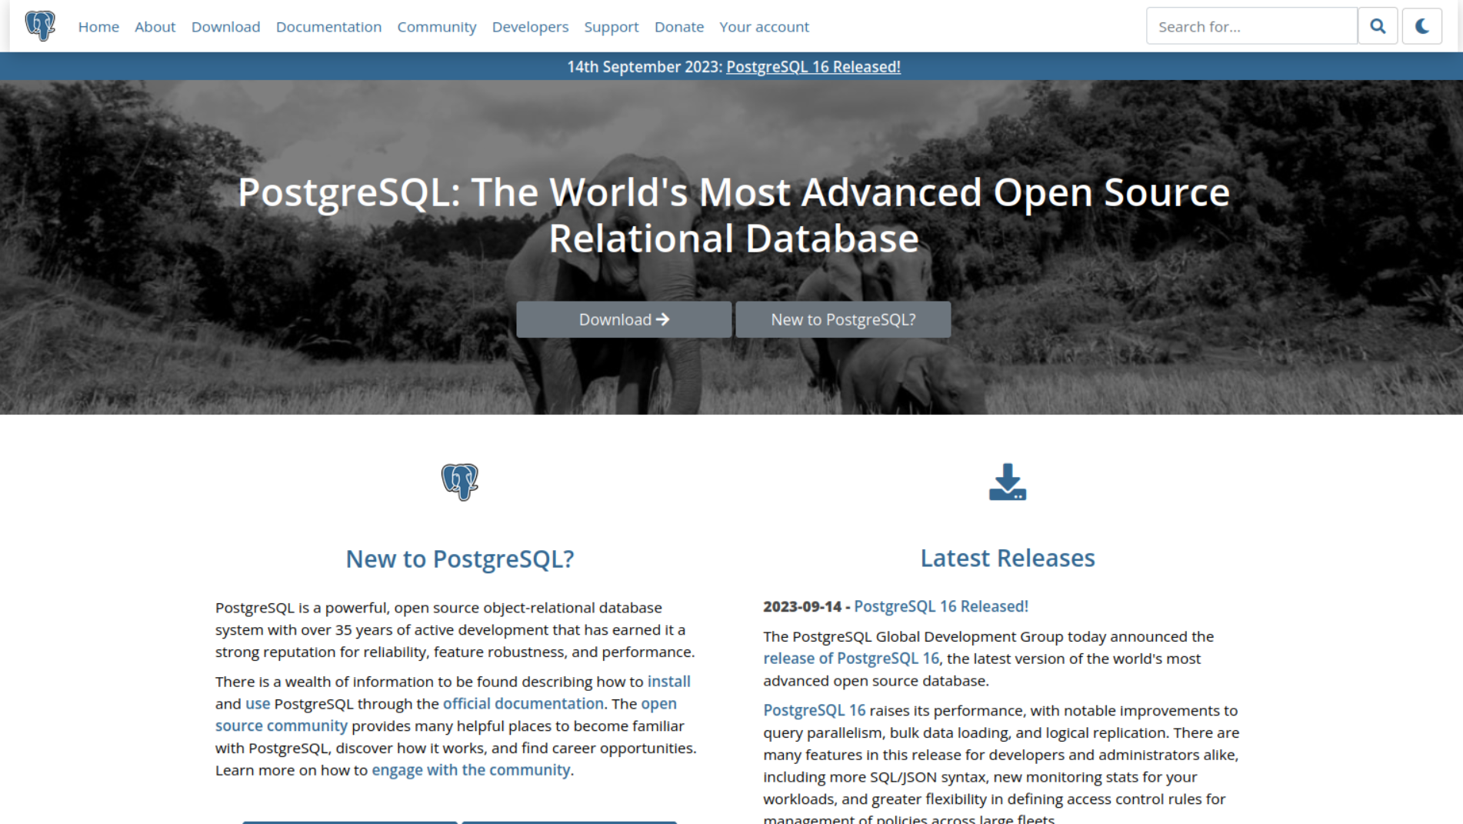
What… Is PgWeb?
Notes:
Let’s get to the Golden Question. What is PgWeb?? Pgweb is the codebase for the official PostgreSQL website. When you think of a website you usually think of some webforms or some informational content but the PostgreSQL website is much more than that and I believe that it is the glue that is holding ou community together.

Slide 6
PgWeb Breakdown
Two repos → pgweb, pgweb-static
Authentication Utilities
40+ Database Table Schemas (running on Postgres ;))
Multiple internal toolings → Documentation Loading Script etc…
Links to various other pg sites
Notes:
So to understand pgweb we have the following points - > 2 repos for pgweb. Pgweb consists of all the code that powers the core functionality of the website while the static repo consists of some extra content that needs to be added as well. We also have the Authentication utilities that power all the web platforms of PostgreSQL including the one that was used for this particular conference. The codebase has over 40+ database schemas which are obviously running on postgres.
Internal tools that are basically used to setup content pipelines on the website and obviously connections to the other postgreSQL websites as well.

Slide 7
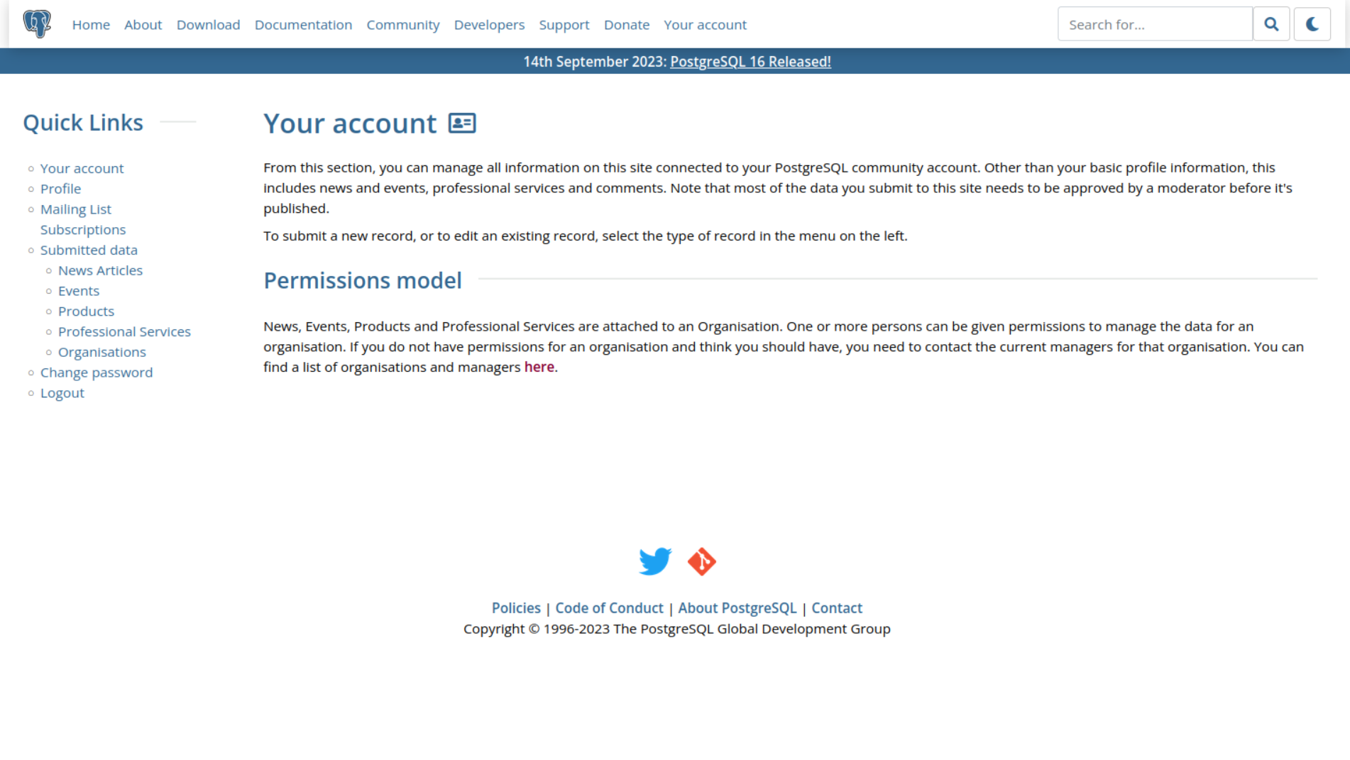
Why…
Do we need to
test pgweb?
Notes:
You might wonder why you need to test a website since the range of imaginable changes over time in website components is not that much as compared to some other type of software. Well the answer lies in the complexity of the codebase. Personally for me this was the starting point in the postgresql community.

Slide 8

About Postgres
Downloads
Much more…
Documentation
Bug reporting
Admin Panel
Web Forms
Events
Notes:
Lets say the person wants to know about PostgreSQL, he might try multiple resources but ultimately he’ll get to the About section of our website. Now let’s say they liked what they saw and they want to download Postgres and run it on their system. They’ll obviously look up the documentation for that. Lets say they liked our database alot and now they want to build a product on PostgreSQL and they want it registered so they’ll probably fill out the product webform on our website. If they want to attend/host a PostgreSQL related event they’ll probably end up on our website. On the community administration side of things we have to show all the requested content on a single dashboard for approvals and what not so we have an Admin Panel for that. And lets say they found some bugs in Postgre so they can also use the bug reporting form on our website! We have much more features but these are the core features of the codebase and all of this is being powered by Django and of course Postgres! And the complexity of it all introduces the chances for any unexpected bugs that might come up and we definitely don’t want to ruin the website as it is the first point of contact for anyone with Postgres.

Slide 9
Problems
Difficult Debugging - Huge Codebase
New patches - but not tested
No Archive for Previous Bugs
Notes:
There were some core problems that we noticed in the codebase. The codebase is pretty huge and difficult to debug, New patches are only tested by local testing and not in a proper sequential and controlled manner. And most importantly we do not have an archive for pgweb bugs, you need to dig up the archives for this.

Slide 10

Notes:
Understand why does pgweb requires a testing harness specifically designed for it in the first place. The first place of contact, the website is the first point of contact for all our users and like a social frontend for Postgres and this needs to be bug free 99% of the time. The codebase is *HUGE* which makes it tough to find the exact problem. There are no tests as such in the current CI pipeline that can validate the actual website build. (ila - also because it is cool! Good way to introduce new contributors to postgres. Especially those who are intimidated by the database internals :))

Slide 11
Our Conclusions
PgWeb is an integral part of Postgres.
The codebase is HUGE.
Relatively difficult to debug.
Need for Test Driven Development.
Notes:
The codebase is an integral part of Postgres in terms of being the first point of contact for anyone. Codebase is huge and difficult to debug,. Dire need for tdd

Slide 12

I'm Slonik, and I approve of this website!
The Harness
The Saviour for PgWeb devs
Notes:
Behold the Testing Harness! Which I personaly love to call “the saviour for pgwebdevs”.

Slide 13
Mission
Monitor PgWeb - from a distance
Test Essential Webforms
Test Authentication according to roles
Test Documentation Loading pipeline
Report dead URLs from the website
Send Errors to concerned individuals
Notes:
More than 60-70% features are there in the codebase now.
We wanted to monitor the pgweb repository but we wanted to do all of that without adding anything to the pgweb repo, so we had to craft out an entire monitoring mechanism for this.
Webforms,
Auth
Test docs pipeline, most well written docs out there, need to keep them up so that when you open the docs one day you wont see a blank screen.
Implemented the following features in 3 months of Google summer of Code

Slide 14
Mission [2]..
Test any build of website
Security Tests (TBD)
Archiving bugs
… All of this in a plug ‘n play format
Notes:
Wish to add all these in the future as well, we’ll discuss them later in detail.

Slide 15
How are we doing all of this?
Utilizing the TestCase Classes available in Django
Selenium for Functional Testing (LiveServerTestCases)
Django ORM for Database access
Unlighthouse for Accessibility Tests
PaLM for report sanitization and possible troubleshooting steps (Expr)
Running In GitHub Actions inside of a Headless browser instance
Notes:
Earlier Planning to Write custom scripts in python using selenium by emulating the Live Server Environment. Although that would have given a lot of control to us but it was not required so we decided to move forward with the existing utilities.
Planning to switch to SQL alchemy.

Slide 16
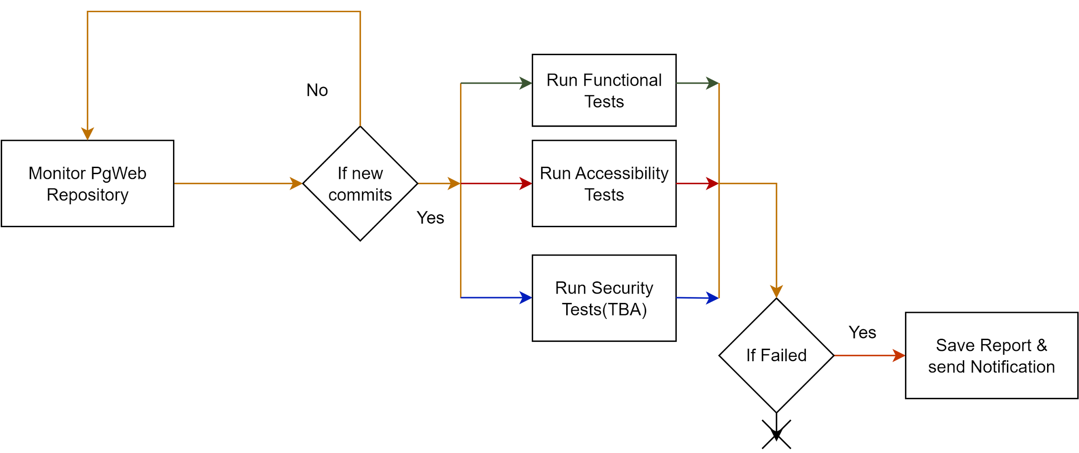
Overview of the Harness
Notes:
Now that we know what needs to be done lets dive into the Harness Internals. It should run 3 set of tests for now it is only running 2 that are the functional and accessibility tests and if there is any failure we end up saving the report and sending it to the concerned individuals.

Slide 17
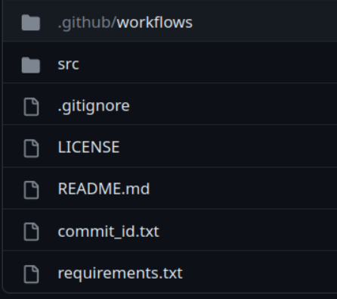
Overview - Directory Structure
Monitor & Run Test Workflows
Main Code base for the Harness
Latest Commit in PgWeb
Libraries Used
Notes:
To understand how the harness works we’ll take the directory structure as a reference. So you can see that we have our workflows set up, all the tests are in the source folder etc etc..

Slide 18
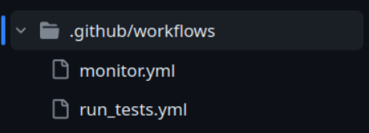
Overview - Directory Structure
CronJob to Monitor The PGweb Repository
Notes:
If we look inside the workflows folder . First of all we have the monitor workflow. This has some other utility bash scripts along with it that enable us to check the pgweb repo

Slide 19
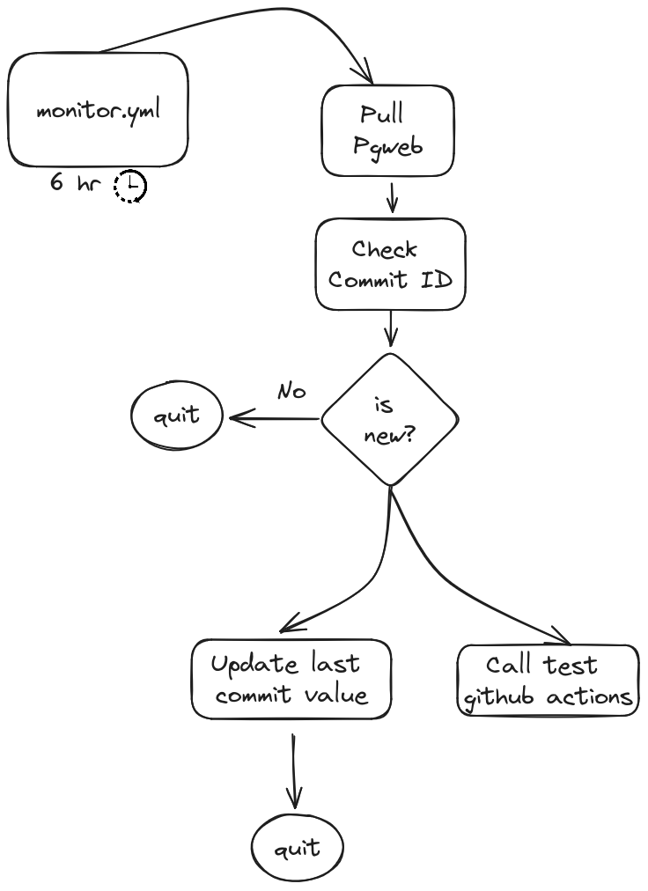
Monitoring
Monitor Cron Job
Utilizing GitHub Actions
Runs 4 times a day
Checks commit Ids
If any changes -> Update last commit value & Trigger Tests
Notes:
Since all of this is done inside a github runner so we cannot essentially keep the repo cloned forever and check for new commits just by using dif or pull.
Runs every 6 hours pulls pgweb checks if there are any new commits call the github action that is responsible for running tests.
This allows us to keep the harness and pgweb separate.

Slide 20
Overview - Directory Structure
Runs Tests if -
Pgweb Changes
Commits to Harness
To Monitor the pgweb Repo
Notes:
The run_tests.yml file is called by the monitor.yml file which automatically triggers the tests if there are any changes in pgweb or any commits to the harness itself.

Slide 21
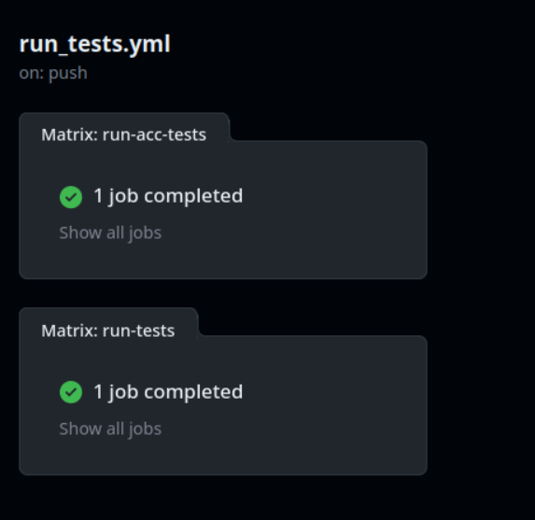
Overview - Tests Workflow
Accessibility Tests
Functional Tests
Notes:
As I mentioned about the workflows, we have two parallel loads that are running, one is for accessibility Tests and other is for functionality tests and we’ll discuss about the functionality tests a little more now.

Slide 22
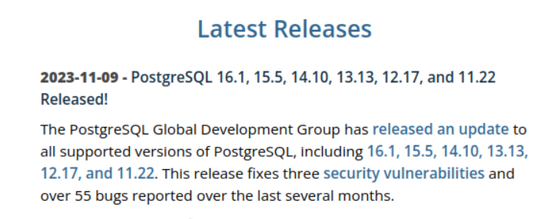
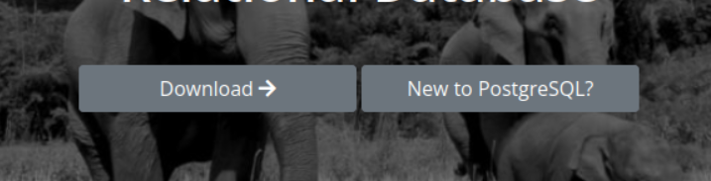
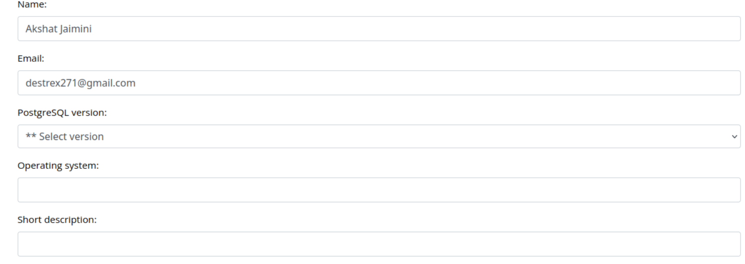
Testing - Functional Tests
Links
Buttons
Forms
Notes:
Equivalent to testing client side features - Testing Whatever the user sees and interacts with on our website. Checking links, buttons and forms regulary. Impossible for humans to do on repeat but a good task for computers to do.

Slide 23
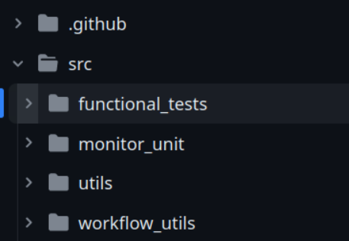
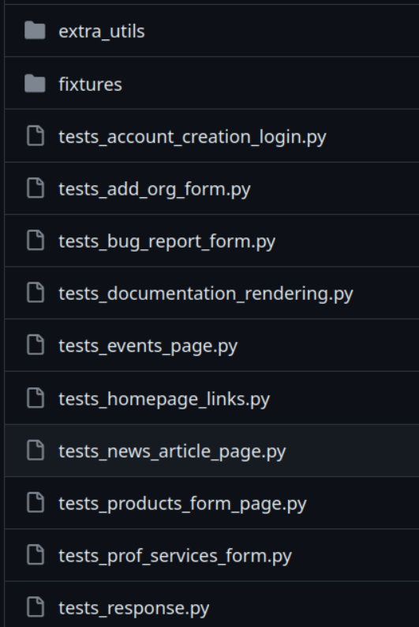
Testing - Functional Tests
Functional Tests for pgweb
Notes:
And all of these tests are stored in the src/functionality_tests folder. So basically when we run our tests in the Github Actions it basically copies all the tests and uses Django to run files as test with a specified prefix, inour case ‘test_’ followed by anything else. We’ll now discuss about two varying tests in the harness . Repository: https://github.com/destrex271/pgweb-testing-harness

Slide 24
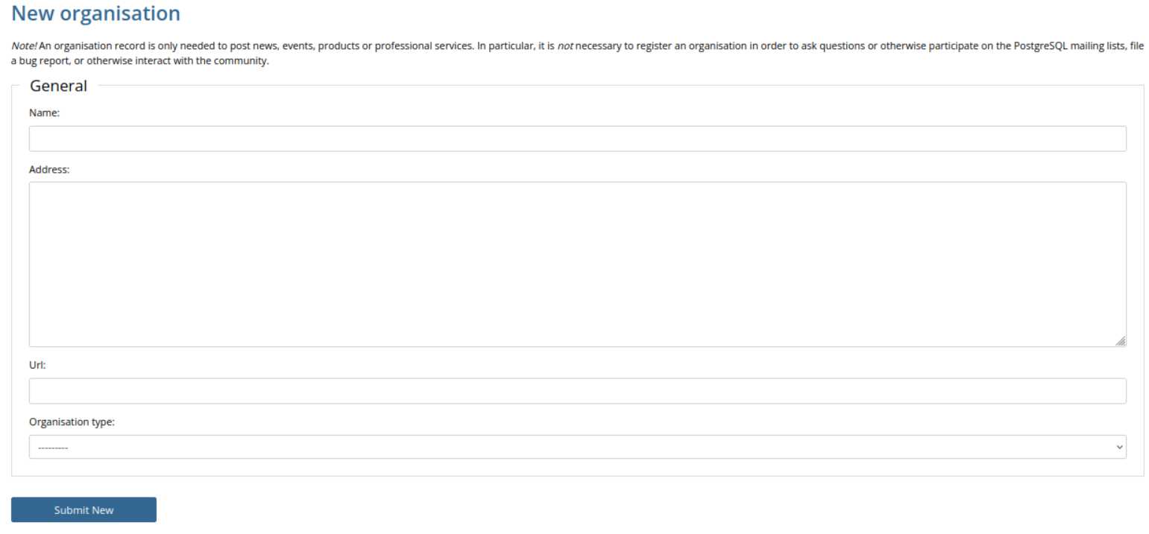
Testing - Functional Tests (Orgs Form)
id_name
id_address
id_url
id_orgtype
Notes:
We’ll take a simple functionality test that is present in the harness to give you an idea of how this process is working. So when you want to reg your org as a Postgres company you will be submitting to this form. As you can see I have some markers associated to each field which is basically the id given to these elements when rendered in a browser. So we use these Ids to automate the entire process of filling the form with data and analyzing the response using Selenium. So if you guys are not aware of selenium just think of it as tool that interact with UI elements in a browser.
File: https://github.com/destrex271/pgweb-testing-harness/blob/main/src/functional_tests/tests_add_org_form.py
Add html code snippet

Slide 25
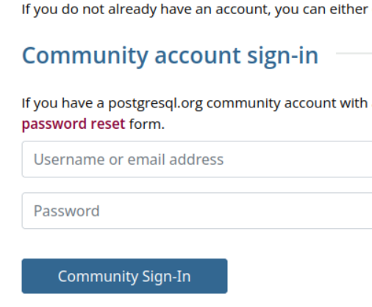
Testing - Orgs Form - Pre configuration
# Login User
self.selenium.get(self.live_server_url + "/")
perm_user = create_permitted_user()
ck = generate_session_cookie(perm_user)
self.selenium.add_cookie(ck)
# Sets the authentication cookies
# in the browser instance
Notes:
File: https://github.com/destrex271/pgweb-testing-harness/blob/main/src/functional_tests/tests_add_org_form.py

Slide 26
Testing - Orgs Form - Automating Fields
# Open Webpage
self.selenium.get(self.live_server_url + "/account/organisations/new/")
# Fill all the fields
self.selenium.find_element(By.ID, self.prefix + "<<field name>>").send_keys(self.org_name)
...
...
# Select items from dropdown
types = self.selenium.find_element(
By.ID, self.prefix + "orgtype").find_elements(By.TAG_NAME, 'option')
k = random.randint(1, len(types) - 1)
types[k].click()
“id_” in this case
For text fields
Choices in drop down
Select Randomly and Click
Notes:
Request selenium to get webpage, find the elements on the site fill em up with content and press the submit button. File: https://github.com/destrex271/pgweb-testing-harness/blob/main/src/functional_tests/tests_add_org_form.py

Slide 27
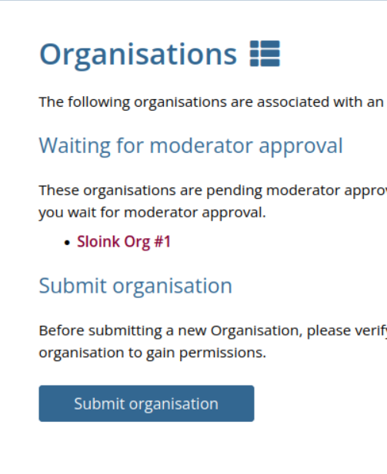
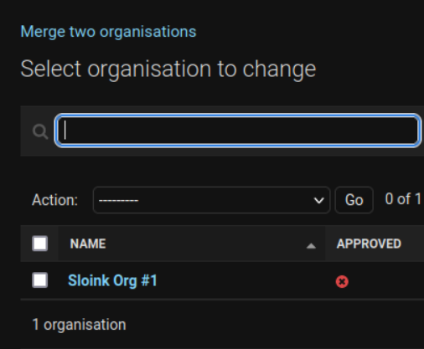
Testing - Orgs Form - On Submit
Frontend
Database
Notes:
Once you submit the data there are two changes - one is that the data is added to the DB and the frontend shows your orgs that are either waited for approval or have been approved. So we designed the test such that it checks for these changes automatically. We have other forms as well that are tested in a similar way
We found another problem tho that in markdown fields urls were not upto date so basically a check was added to see if the urls provided were good. This patch was for pgweb to make our lives easier at the testing harness but Magnus has been really busy with conference so I hope he merges it as soon as this is over. ;)

Slide 28
Testing - Orgs Form - Checking Response
# Check if the page was redirected to organisations
heading = self.selenium.find_element(By.TAG_NAME, 'h1').text
self.assertEqual(heading.lower().strip(), 'organisations')
# Check if org is listed on the frontend
li = self.selenium.find_element(
By.XPATH, "/html/body/div[2]/div/div[2]/div/ul").find_elements(By.TAG_NAME, 'li')
txt = []
for l in li:
txt.append(l.text)
self.assertTrue(txt.__contains__(self.org_name))
# Check Against Database
x = Organisation.objects.filter(name=self.org_name)
self.assertNotEqual(len(x), 0)
Frontend Check
DB Check
Notes:
File Link: https://github.com/destrex271/pgweb-testing-harness/blob/main/src/functional_tests/tests_add_org_form.py
Replace with something visual

Slide 29
“ The first place to go to for any questions on PostgreSQL is its world-renowned documentation”
Pg Website

Slide 30
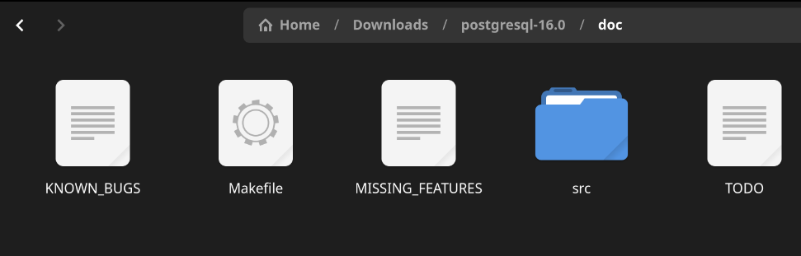
Testing - Functional Tests - Docs pipeline
Docload Script
Actual Release Documentation
Notes:
This is my fav part of the harness. So we saw a small test that just checks the user data right? Now we look into the internals of the postgres website! The docs pipeline is not a user feature but a server side setup that we use to load our beautiful docs on the website. PostgreSQL has the most amazing docs and we wish to keep them available all the time. Docload Script: https://github.com/postgres/pgweb/tree/master/tools/docs/docload.py

Slide 31
The Original Docload Script
Download the documentation
Run the tools/docload.py script as follows:
docload.py <<Version Number>>> postgresql-<<version number>>.tar.gz
Decompress the Tarball files
Automatically Tidies up the HTML documentation
Adds the loaded docs meta info to the Database
Notes:
The actual flow in Pgweb.
Original Script: https://github.com/postgres/pgweb/tree/master/tools/docs
This script will load a new set of documentation. Simply specify the version to load and point out the tarball to load from. The script will automatically decompress the tarball as necessary, and also perform HTML tidying of the documentation (since the HTML generated by the PostgreSQL build system isn't particularly standards-conforming or nice-looking).

Slide 32
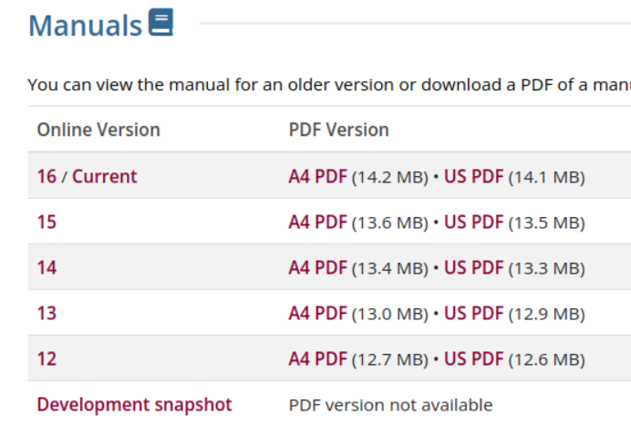
What does the Harness Change?
Scrape the Latest Versions of PostgreSQL.
Notes:
We added some changes of our own to this process to automate it successfully.
We scrape latest PostgreSQL versions.
Original Script: https://github.com/postgres/pgweb/tree/master/tools/docs

Slide 33
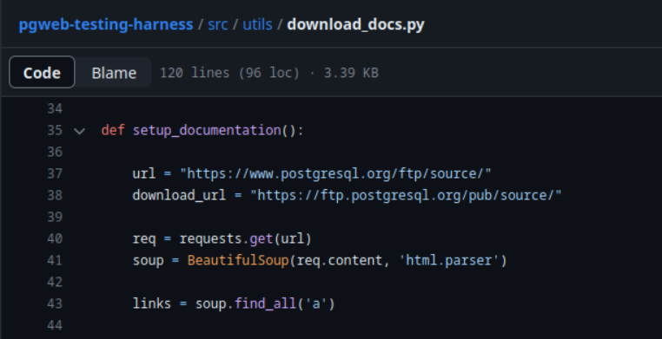
What does the Harness Change?
Downloads All the latest docs for the scraped Versions
Prepares The DB Entries for the Docs
Runs The Docload
Script for each version.
Notes:
After that we download all of them and prepare the db entires then proceed to run the docload script for each of them
Download Doc Script: https://github.com/destrex271/pgweb-testing-harness/blob/main/src/utils/download_docs.py
This script will load a new set of documentation. Simply specify the version to load and point out the tarball to load from. The script will automatically decompress the tarball as necessary, and also perform HTML tidying of the documentation (since the HTML generated by the PostgreSQL build system isn't particularly standards-conforming or nice-looking).

Slide 34
Checking the Rendered Docs
while len(urls) > 0:
# Extracting Content from Documentation Page
page = requests.get(url)
soup = Bsoup(page.text, "html.parser")
content = soup.find_all(id='docContent')
content = content[0].get_text()
. . .
# Navigating to the Next Pages
nav_btns = soup.find_all("a")
next_url = None
for btn in nav_btns:
if btn.get_text() == 'Next':
next_url = base + '/' + btn.get('href')
if next_url:
urls.append(next_url)
But doing it Sequentially for each Page and that too for each version is
REALLY SLOW!!!!!
Notes:
Once the docload pipeline works we check each documentation page by page. Thus automating a boring task and saving us a lot of time. Took 20+hrs to check each page
Download Doc Script: https://github.com/destrex271/pgweb-testing-harness/blob/main/src/utils/download_docs.py
This script will load a new set of documentation. Simply specify the version to load and point out the tarball to load from. The script will automatically decompress the tarball as necessary, and also perform HTML tidying of the documentation (since the HTML generated by the PostgreSQL build system isn't particularly standards-conforming or nice-looking).

Slide 35
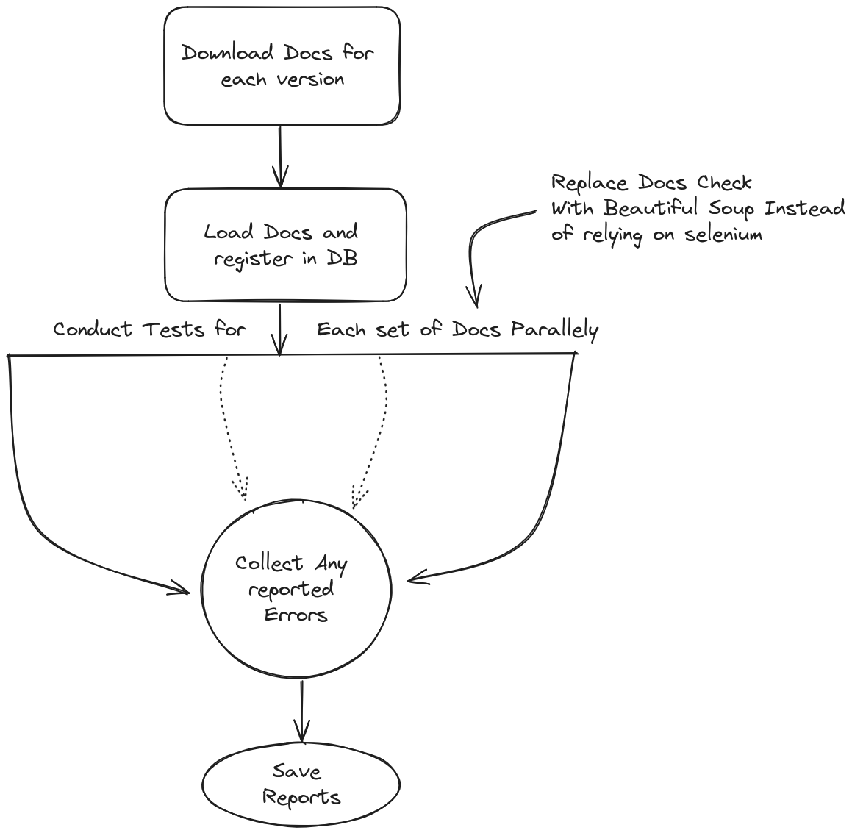
Optimizing the Docload Tests
Use A lighter Alternative to scan Documentation.
Conduct All the Tests in Parallel.
20+hrs -> 5 hrs -> 5 mins!
Notes:
Multithreading added where each docs version has its own thread. We also replaced selenium where it was not required with BS4 as it does not rely on opening and maintaining browser instances itself. Now I think you have a clearer picture of how the tests vary
That was all for the functionality tests so this was just a spectrum of what tests are there and you are free to toy with this range as much as you can. Up next
ad Doc Script: https://github.com/destrex271/pgweb-testing-harness/blob/main/src/functional_tests/tests_documentation_rendering.py
This script will load a new set of documentation. Simply specify the version to load and point out the tarball to load from. The script will automatically decompress the tarball as necessary, and also perform HTML tidying of the documentation (since the HTML generated by the PostgreSQL build system isn't particularly standards-conforming or nice-looking).

Slide 36
Testing - Accessibility Tests
Why?
Ensuring Compliance with WCAG Standards
Lack of alt text for images
Inconsistent color contrast
Unusable keyboard navigation
Notes:
We have accessibility tests! Explain Accessibility Tests. Improves UX. Includes this stuff

Slide 37
Testing - Accessibility Tests
Available Tools
WAVE Evaluation Tool
aXe
Lighthouse by Google
Unlighthouse
Notes:
Earlier we thought of developinbg everything from scratch but now we can use the accessibility tools that are open source without going thru that headache.

Slide 38
Testing - Accessibility Tests
Reasons to Use Unlighthouse
Integrates Directly with CI interfaces
Conducts a site wide testing
Customizable Report Formats
It’s Open Source!
Notes:
Earlier we wanted to build everything from scratch but decided against it. Reasons to use Unlighthouse over other tools. As unlighthouse conducts site wide search.

Slide 39
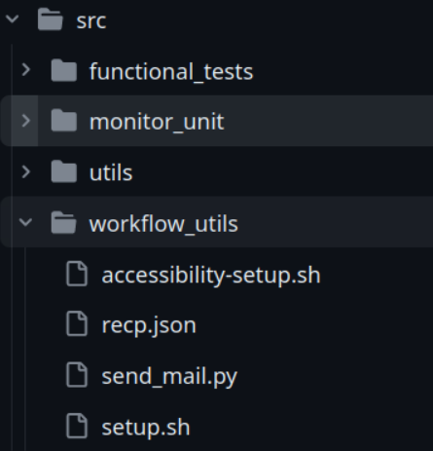
Testing - Accessibility Tests
Unlighthouse CI
Reports in HTML format
Spins up a live development build of the website with dummy data to emulate the actual website
Notes:
Unlike functional tests all these are in a single bash script that sets up and runs Unlighthouse in Github Actions

Slide 40
Environment Setup
Copy
Clone
Install
The code from the testing Harness
Pgweb in the container
Dependencies for harness and pgweb
Setup
Copy
Setup
PostgreSQL client for DB communication
Tests in the pgweb repo
Default Data for dev build & admin setup
Notes:
GitHub Actions provide us an ubuntu container. Since these tests are being run inside of GitHub Actions, we need to configure the test environment before executing any tests

Slide 41
Failure Reporting Mechanism
Collect
Check
Summarise
All reports from the tests
For any Failures
Reports using PaLM with possible fixes
Complain
Save
By sending the reports to the concerned
Failure Reports to setup an archive
Time to Complain!!
Notes:
Now its time to complain!
Once tests are done, we check for failures, summarize the reports. Magnus is the first one who ends up responding to my complaints

Slide 42
The Story So Far….
What is PgWeb?
Why do we need to test PgWeb?
How does the Harness Help in this task?
Details about some of the Prominent Tests

Slide 43
What’s Ahead? - Upcoming Features
Archiving Log Reports
Ability to Test various builds of pgweb using commit ids
Security Tests
Better Crawling Mechanism for URL validation
Content Validation across pgweb
Extension for Other PostgreSQL websites
Notes:
Earlier Planning to Write custom scripts in python using selenium by emulating the Live Server Environment. Although that would have given a lot of control to us but it was not required so we decided to move forward with the existing utilities.
Planning to switch to SQL alchemy.

Slide 44
How can YOU help us?
Add Tests for your pgweb patches… please
Check Harness Logs for any existing issues
Check Harness Logs after merging any patches
Compete with the harness!
Contribute to this initiative!
Notes:
Ultimate goal of this talk was to introduce everyone to this amazing tool that we have been working on and motivate you guys to contribute to this awesome initiative.
Ironic situation the harness tests pgweb and pgweb tests the harness

Slide 45




Thank You!
LinkedIn
Kyllex5
Watch The Harness in Action here
destrex271

Slide 46
Questions ?
Notes:
Dedicated test to pinpoint the exact problem.

